Slide 1
ART BIBLE
Laia Pachón Pérez

Slide 2
Table of contents
What is an Art Bible?
When is created?
Who creates it?
What makes?
Question we can answer with an Art Bible
Contents
Art style
Character Art
L.O.D
Camera
Color Palette
Environment/Atmosphere
Texture ans Surface
User Interface
Technical guidelines
References.
Visual Resources

Slide 3



What is an Art Bible?
When is created?
Who creates it?
Reference design document
What the artists have to do
After GDD and before Art Production
Art director

Slide 4

What Makes?
How is the game
Help the art team
Explain the decisions
Communication

Slide 5

Questions we can answer with the art bible
What a new member of the team should know about the art of the game
Target
What sponsors and investors should know
How to explain to the team how to do the artwork

Slide 6
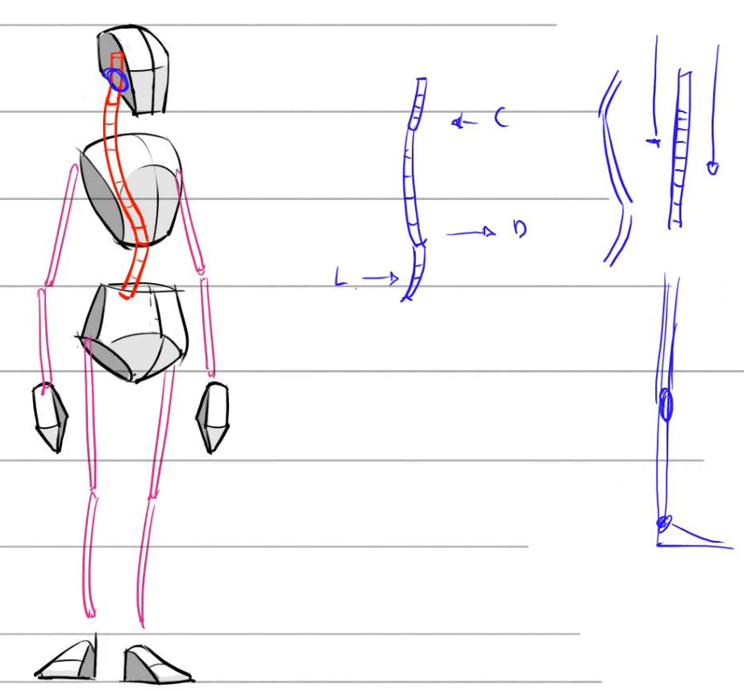
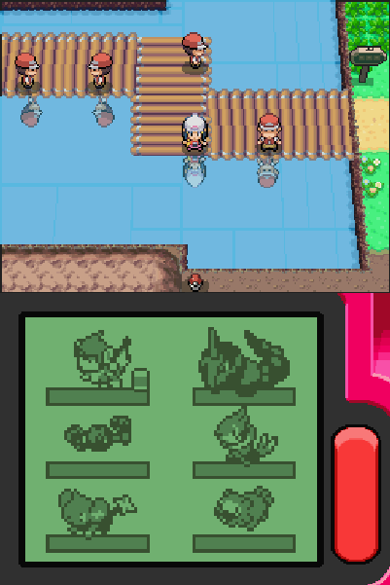
Art Style
Graphic style (2d/2.5d/3d/Realistic/Stylized/Cartoon/PixelArt)
Weather/time
Environment/atmosphere
General color palettes
How to draw
Tips/hints/advancements

Slide 7
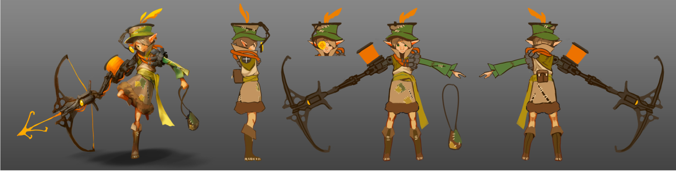
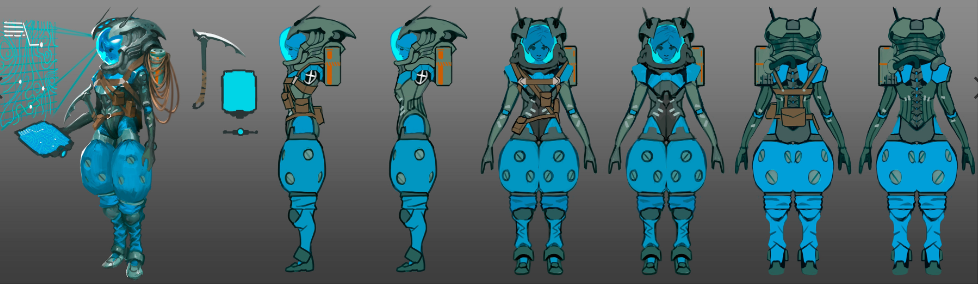
Character Art
Sketches
Concept art
Expressions of the character
Character poses
Scale comparison with other elements of the scene
Style and Creation
Clothes and accessories
Color Palette

Slide 8
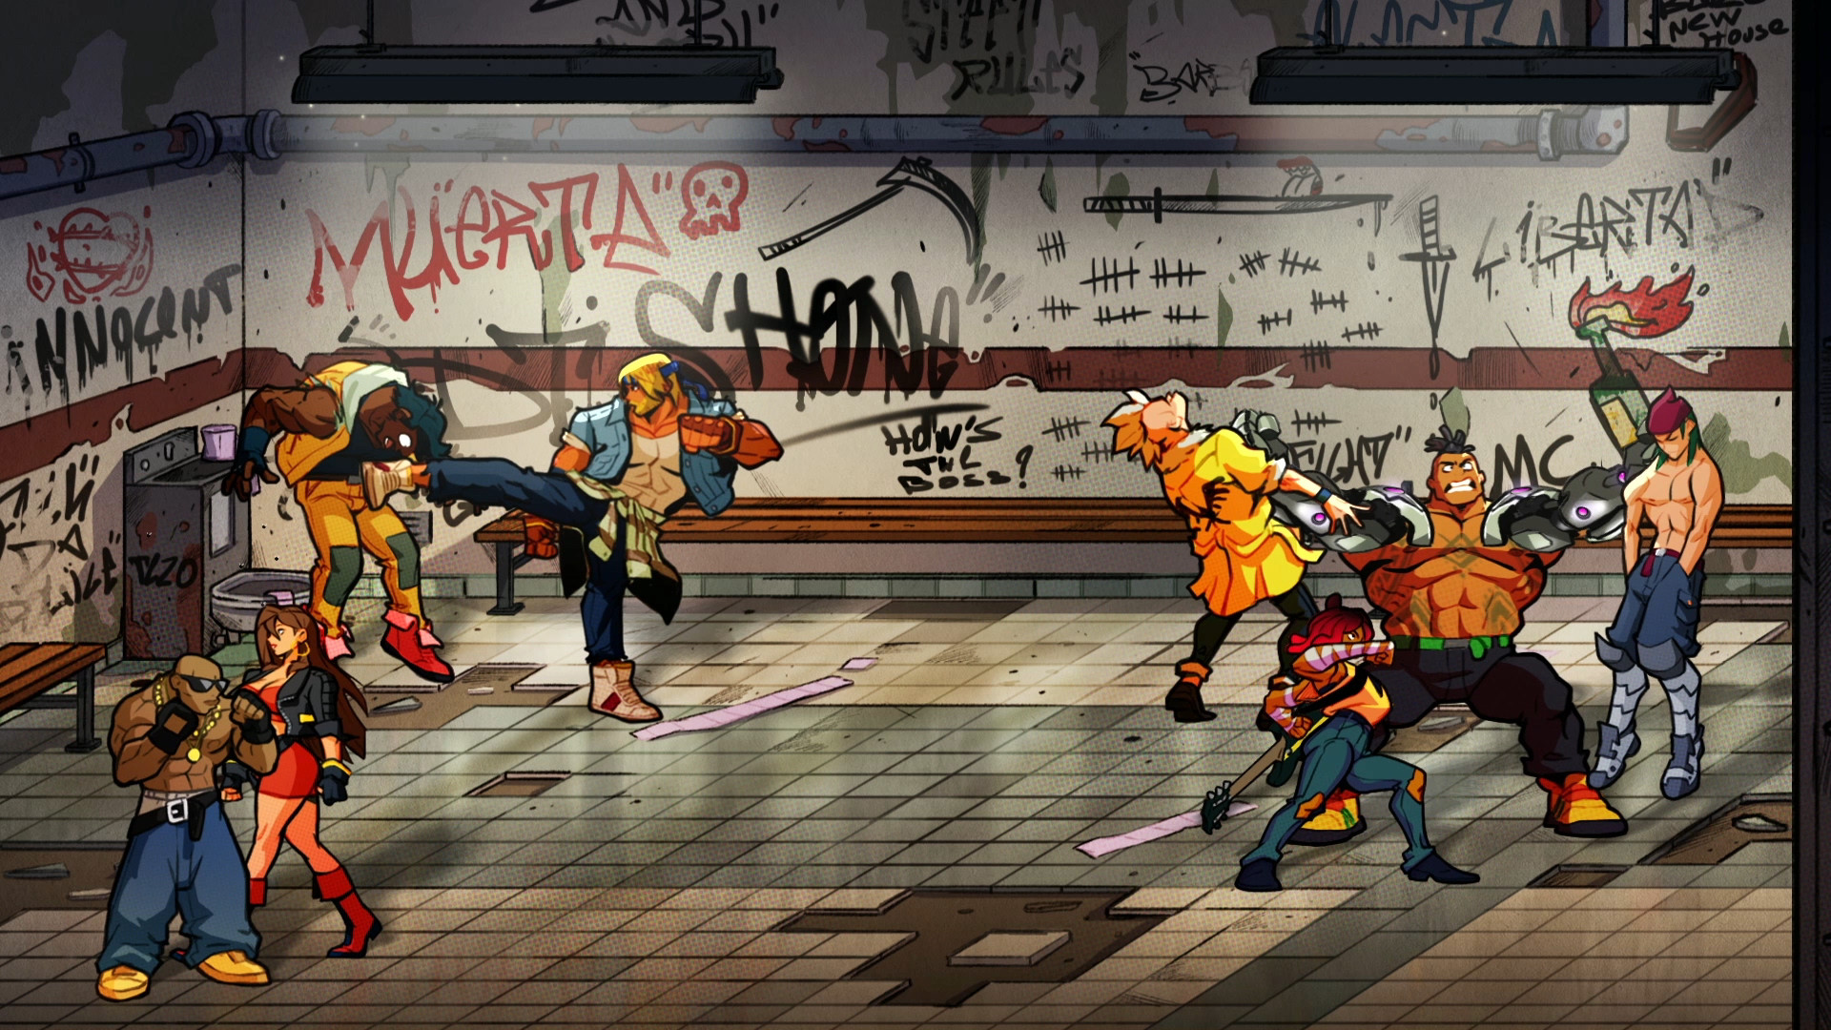
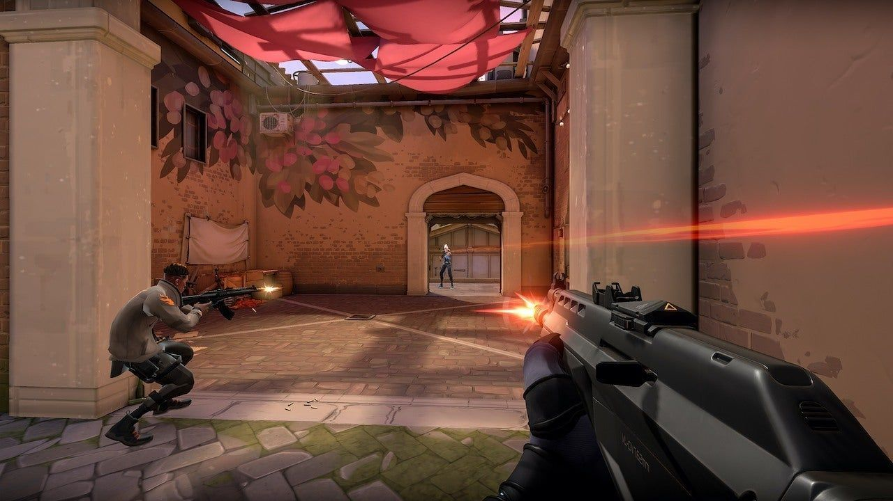
L.O.D
Level of Details
Difference between Gameplay, Camera, UI
How to increase and decrease the level of details
What has to be detailed and what not
Architectonic details
Character details.
Street of Rage 4
Valorant

Slide 9
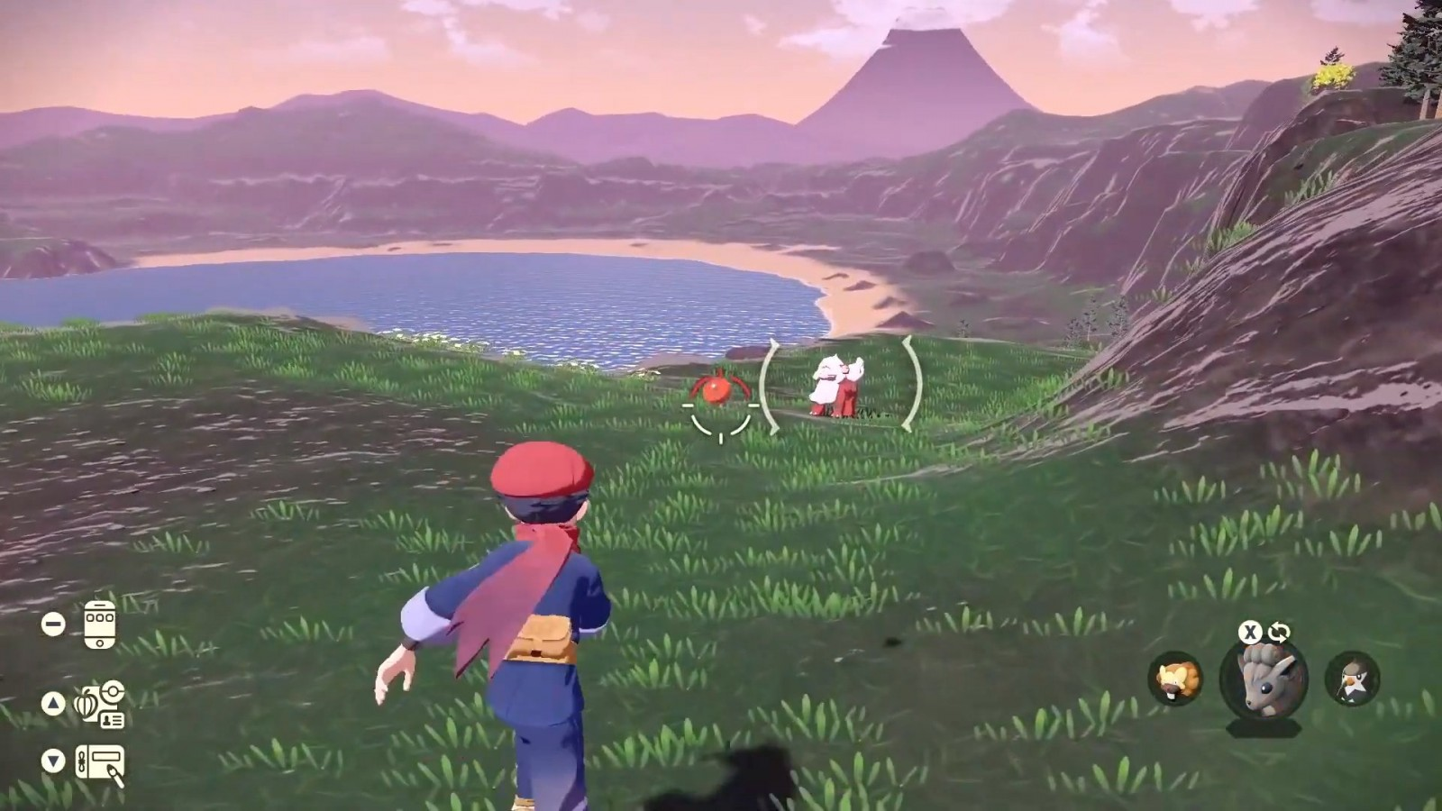
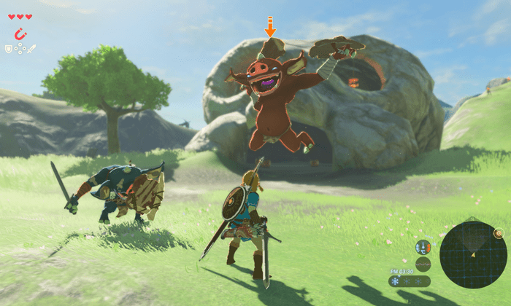
Pokemon Arceus
Zelda BOTW

Slide 10
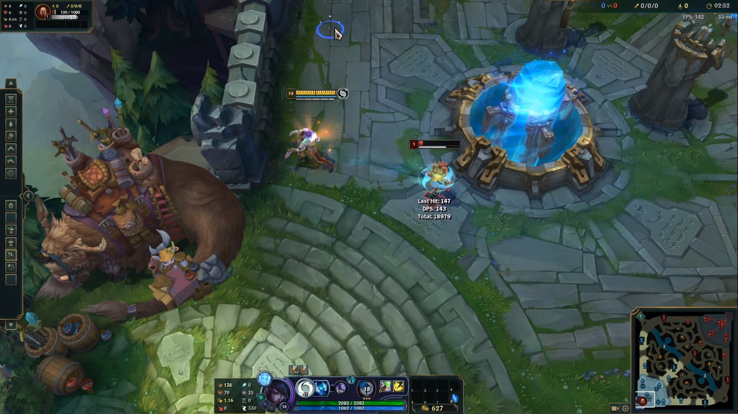
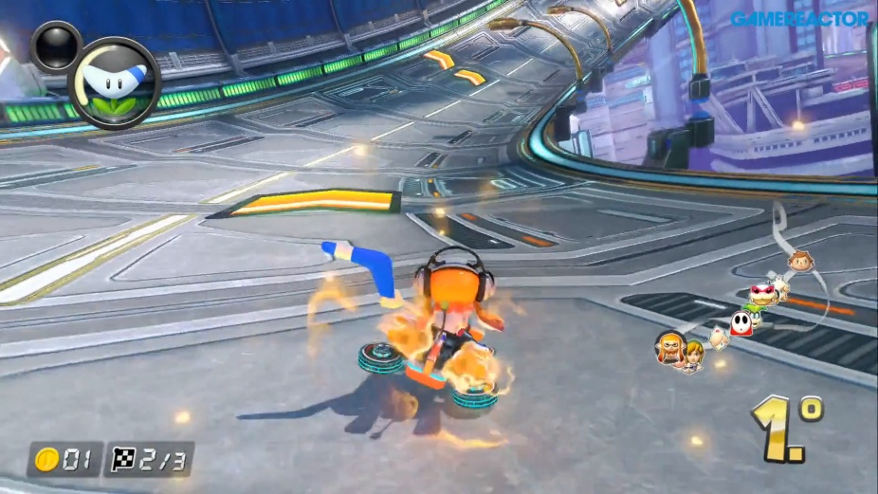
Camera
POV
Perspective
Character position
Transitions
Field of view
Effects
Cutscenes
League of Legends
Mario Kart 8 Deluxe

Slide 11
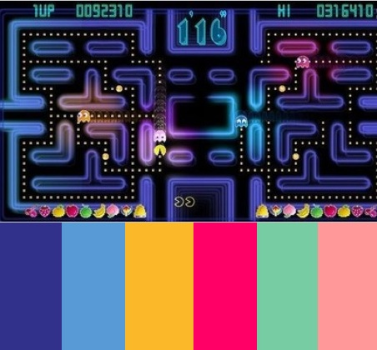
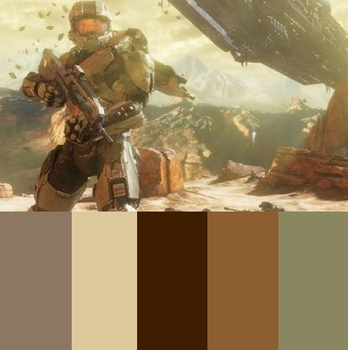
Color Palette
Color samples
Hues
Values and vitality
Saturation
Distinct between important and not important things
Pac-Man
Halo 4

Slide 12
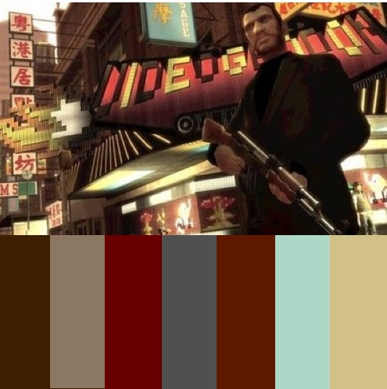
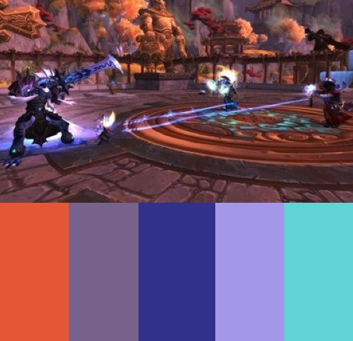
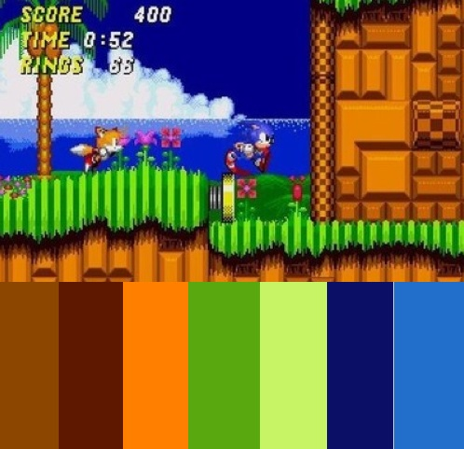
Sonic the Hedgehog 2 (1992)
Grand Theft Auto IV
World of Warcraft

Slide 13
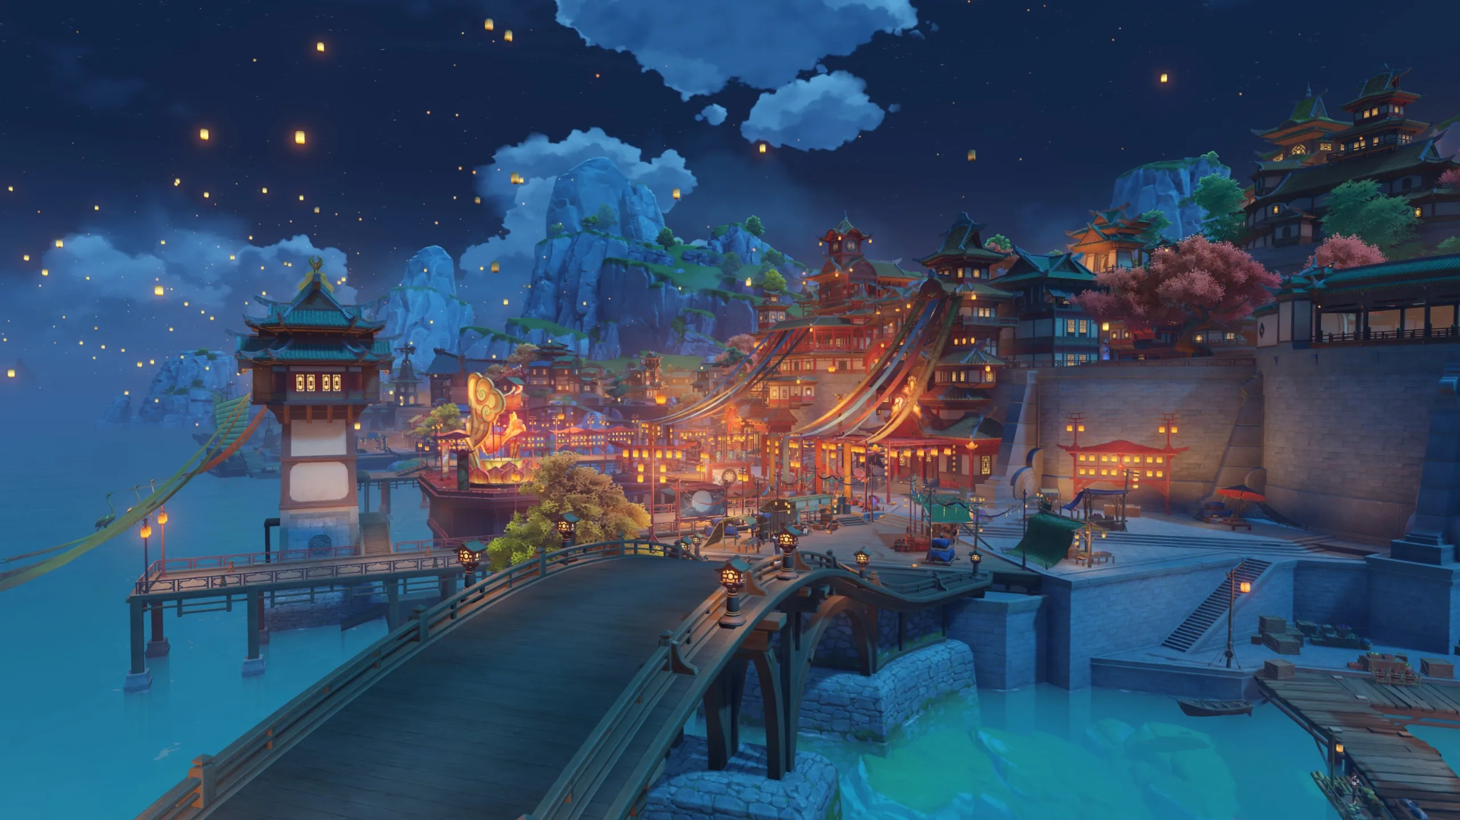
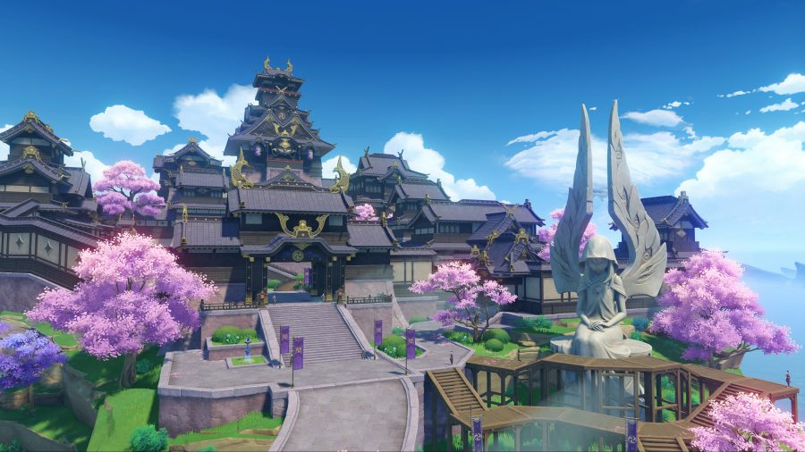
Environment/Atmosphere
Scale
Scheme (importance of elements)
Weather
Elements
Genshin Impact (Liyue)
Geo/China
Genshin Impact (Inazuma)
Electro/Japon

Slide 14
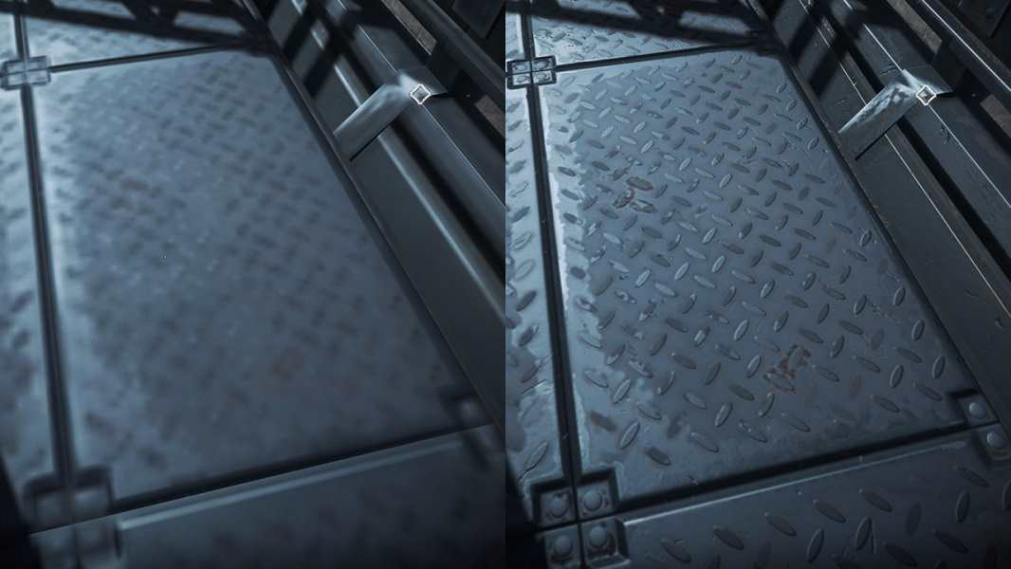
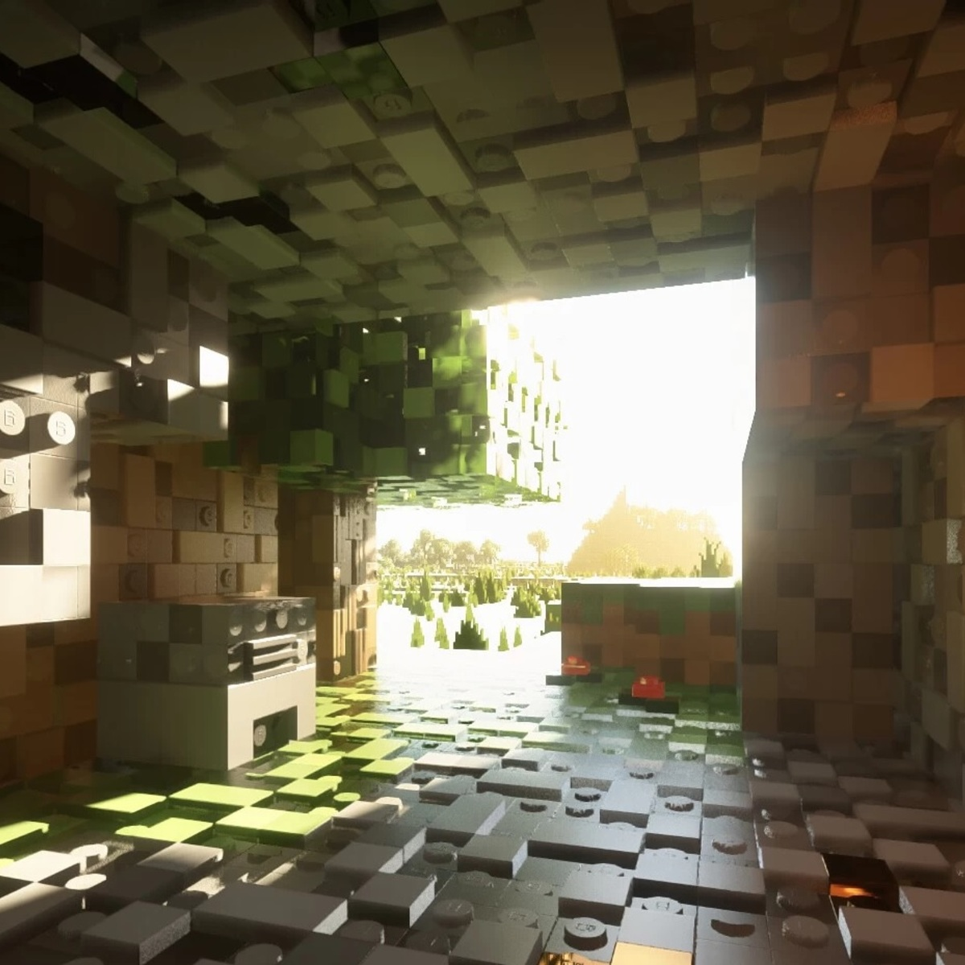
Texture & Surface
Which texture
How to use them
Minecraft

Slide 15
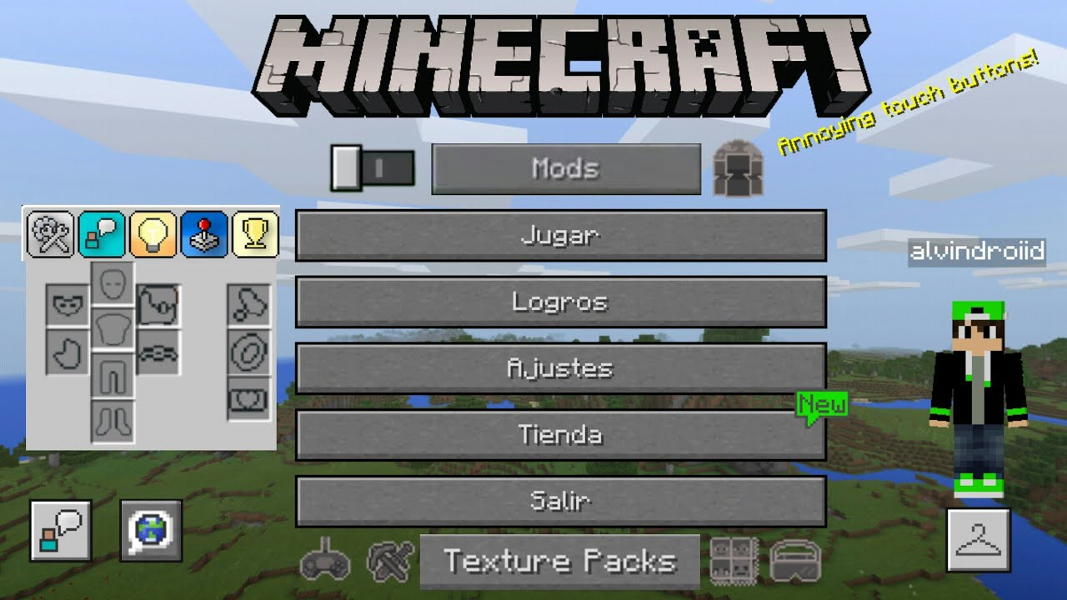
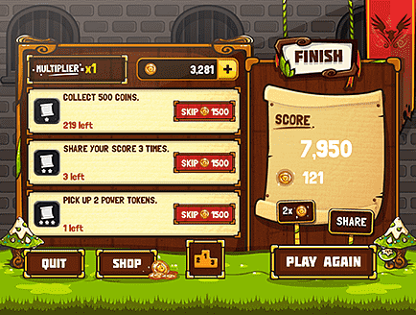
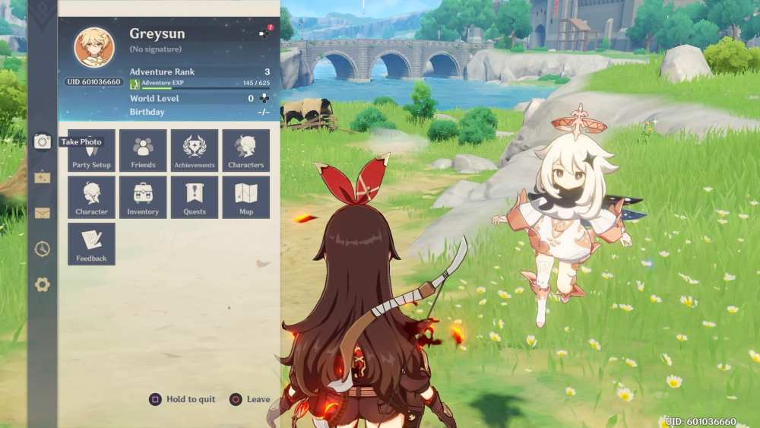
User Interface
Animations
Menu items and hud
How to implement the UI design
Minecraft
Genshin Impact

Slide 16
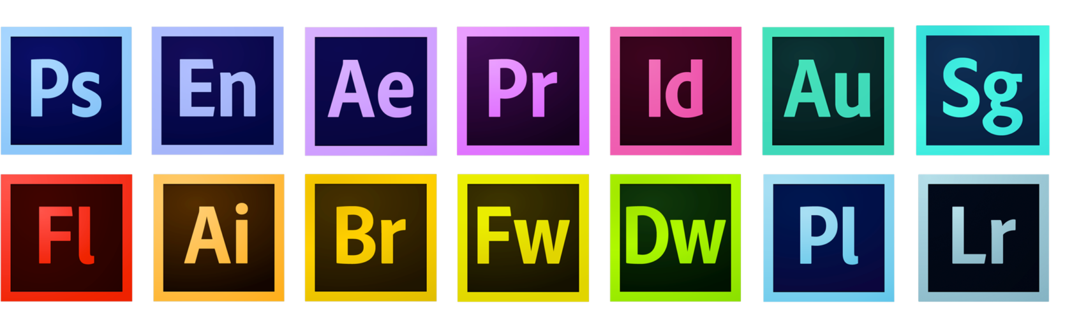
Technical Guidelines
Exportation
Naming connections
Tools
Limitations
Structure of the work

Slide 17
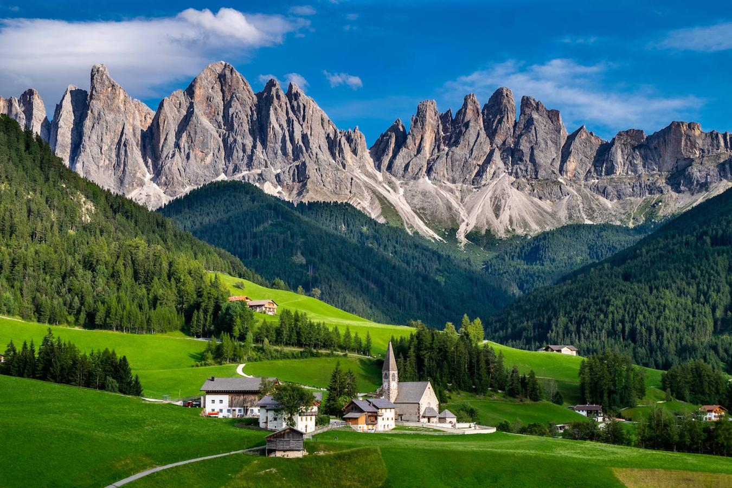
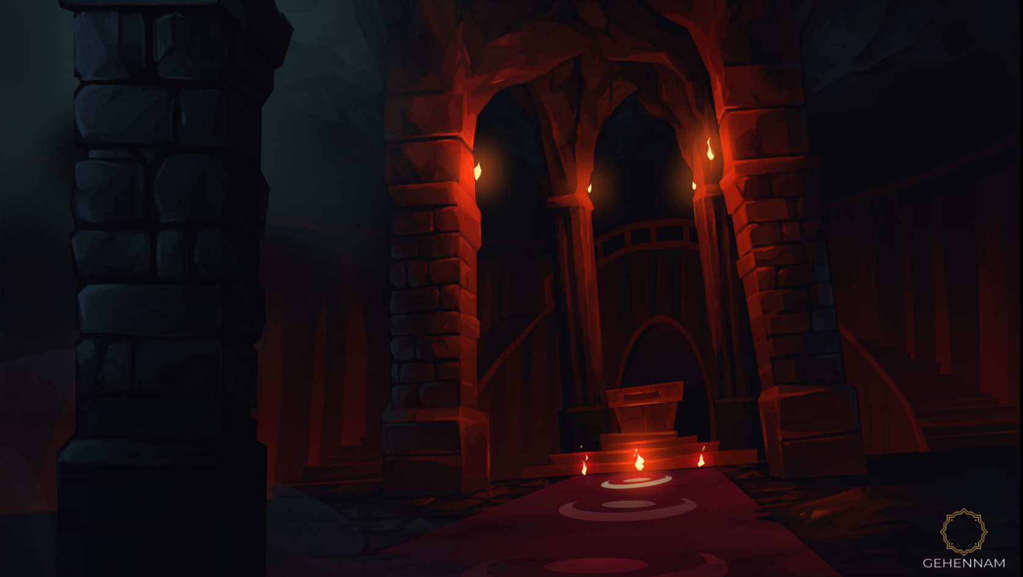
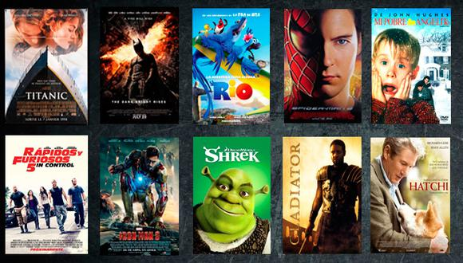
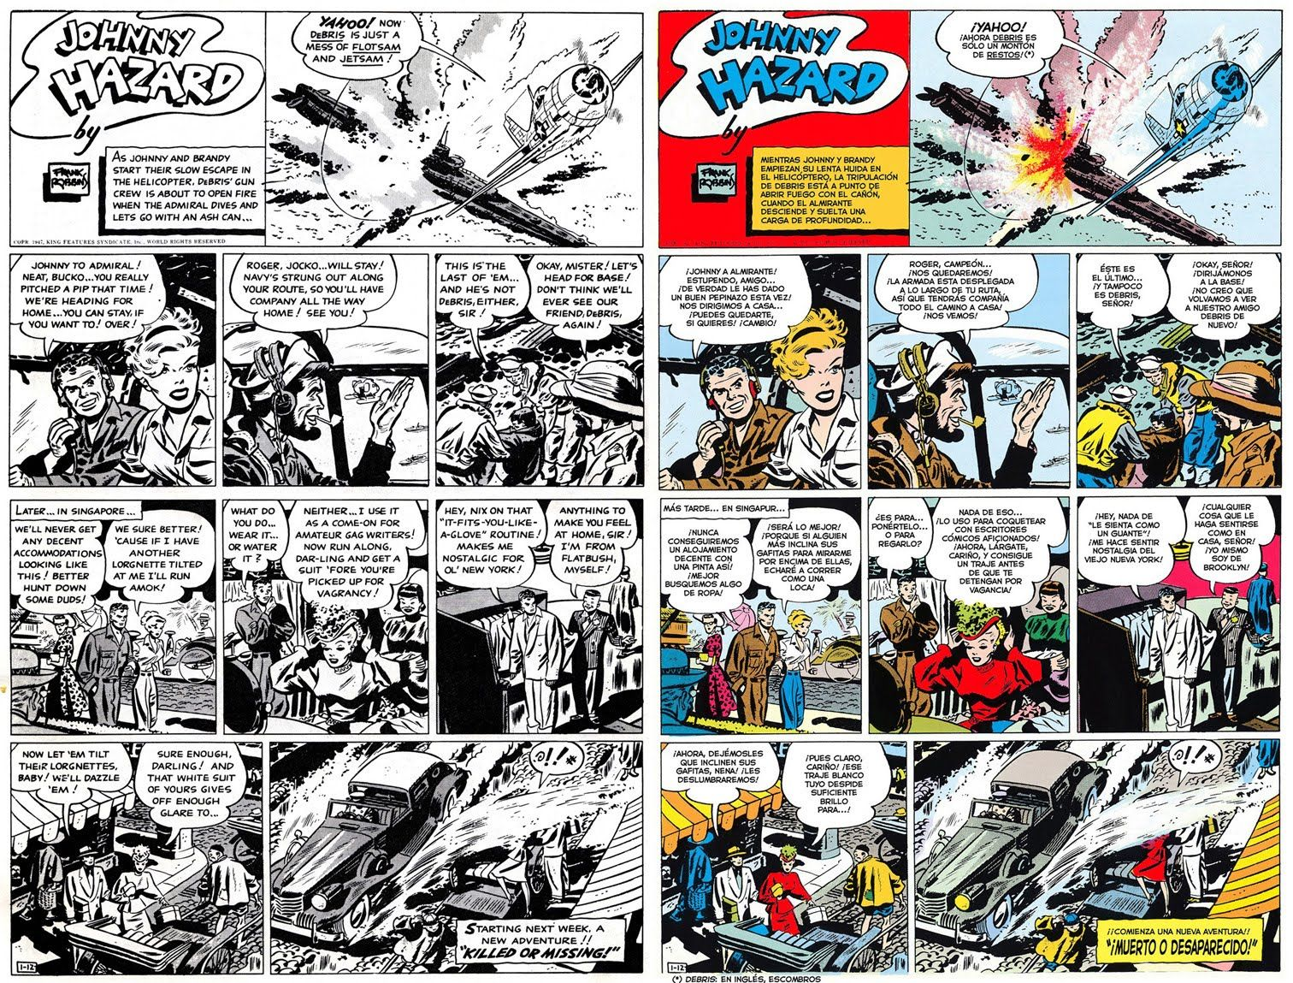
References
Photographs
Illustrations
Ads
Movies
Games
Comics

Slide 18
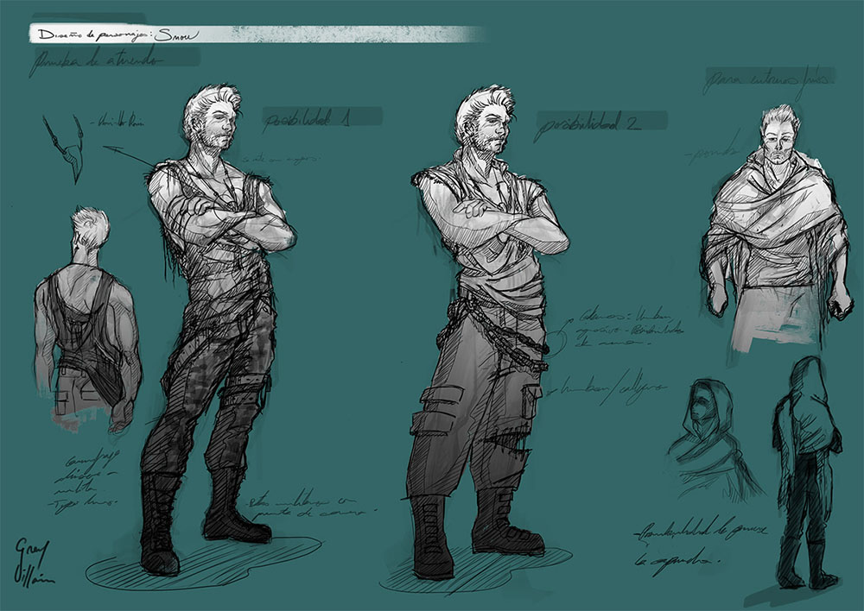
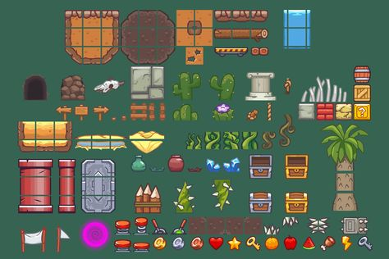
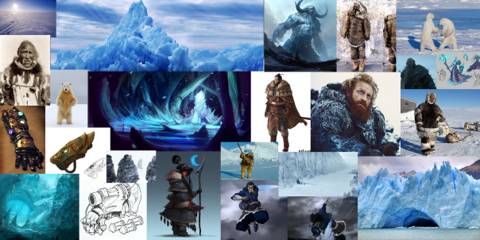
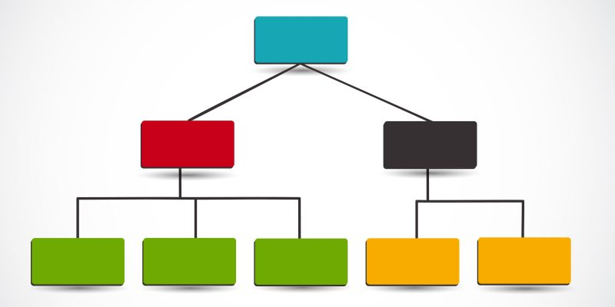
Visual Resources
Concept art
Photographs
Diagrams
Assets
References
Moodboard

Slide 19
Documentation
https://www.artstation.com/artwork/e0xQ8b
https://www.artstation.com/artwork/A8v2y
https://www.artstation.com/artwork/nAYke
https://www.muycomputer.com/2020/12/27/juegos-con-mejores-graficos-de-2020/
https://conexionmoda.com/noticias/3385_-influencias-de-los-video-juegos-en-el-color
http://www.dota2.com/workshop/
https://willytrek19.github.io/ArtBible/
https://www.slideshare.net/kshiraj/game-art-bible-secret-sauce-to-making-great-game-art
Videos:
https://www.youtube.com/watch?v=gUEfG4c8mTk&t=180s
https://www.youtube.com/watch?v=X34ykTj7Hbo
Github page: https://github.com/laiapachon/Art-Bible
Github web: https://laiapachon.github.io/Art-Bible/

Slide 20
ART BIBLE
Laia Pachón Pérez

